Slide 1

Turo 2.0 Marketing Strategy
By:
Adarsha Piya
Saran Padmakar
Nidhi Wanjare
Tanvi Raddi
Nikita DaSilva
Diana Almeida

Slide 2
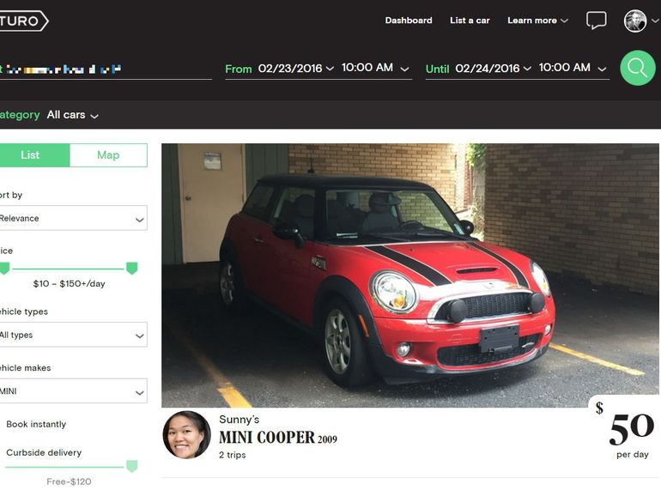

Introduction
TURO
Our Objective
Problem Statement

Slide 3
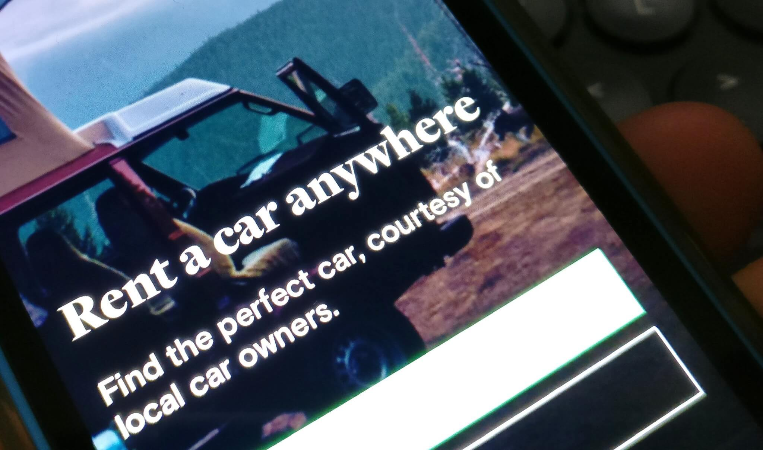
Turo
What is it?
- “Airbnb for cars”
- A peer-to-peer car renting marketplace from local hosts
- Currently trying to expand in the North Americans and
European marketplace.
What does it do?
- Provides a platform for consumers to conveniently rent
affordable cars from car owners that have spare cars
sitting idly.
Turo Ad

Slide 4

Our Objective
Propose an effective marketing plan
to maximize Turo's revenue and
market share through building
consumer awareness of a better,
less-costly alternative to car rentals.

Slide 5
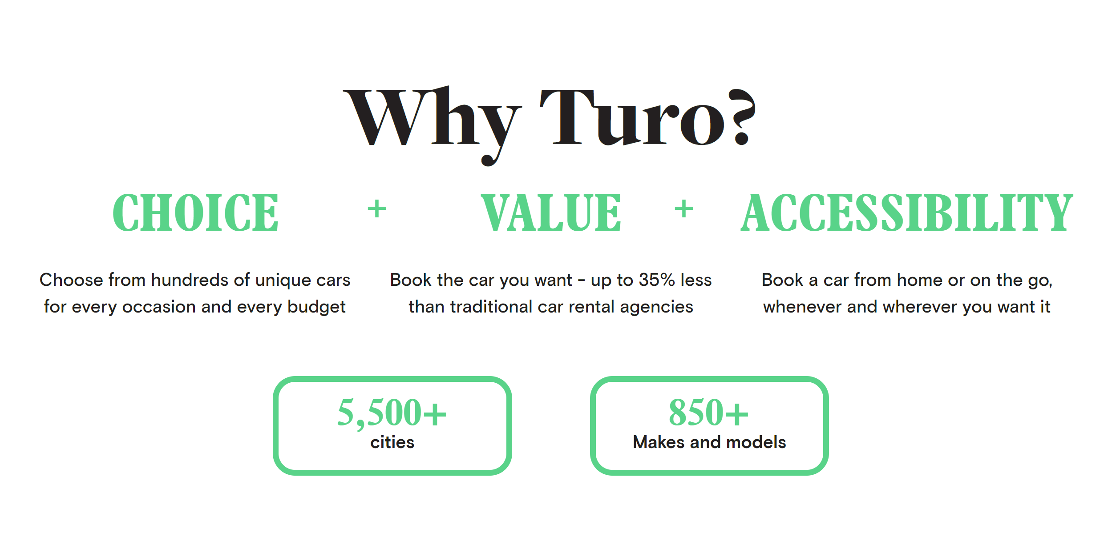
Problem Statement
What are the problems?
Idle cars not being utilized, high Cost, inconvenient, less variety of cars, companies try to oversell products.
What are the points of difference?
Use idle cars to generate revenue
Cost Saving: referral discount, first-time consumer
discount, no minimum rental time
Convenience: drop-off, mobile apps, mileage pricing,
insurance
- Variety: wide range of models, luxury, vintage
What strategic advantage does Turo have over competitors in terms of variety?
- Traditional companies' capital restriction causing inventory limitation: fewer luxury cars, less options, higher company and rental costs
- Do not own the cars; no capital restrictions: more options, less expenditure, less-costly and better deals for customers.

Slide 6
Situational Analysis
Consumer and Demand Analysis
Competitor Analysis
Segmentation, Targeting and Positioning
SWOT Analysis

Slide 7
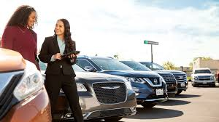
Consumer and Demand Analysis
Price sensitive customer
International/ Out-state Student
Business Trip
Potential Customers
Leisure/
Travel

Slide 8

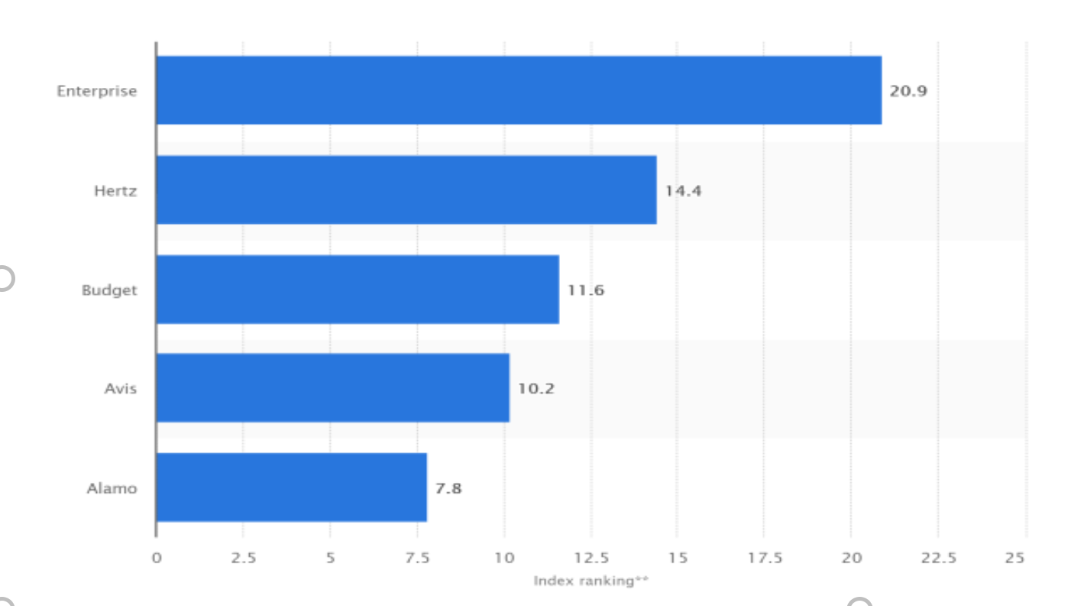


Competitor Analysis
Who are the competitors?
Car Rental: Leading car rental companies in U.S in 2018
Data Source: Statista.com

Slide 9

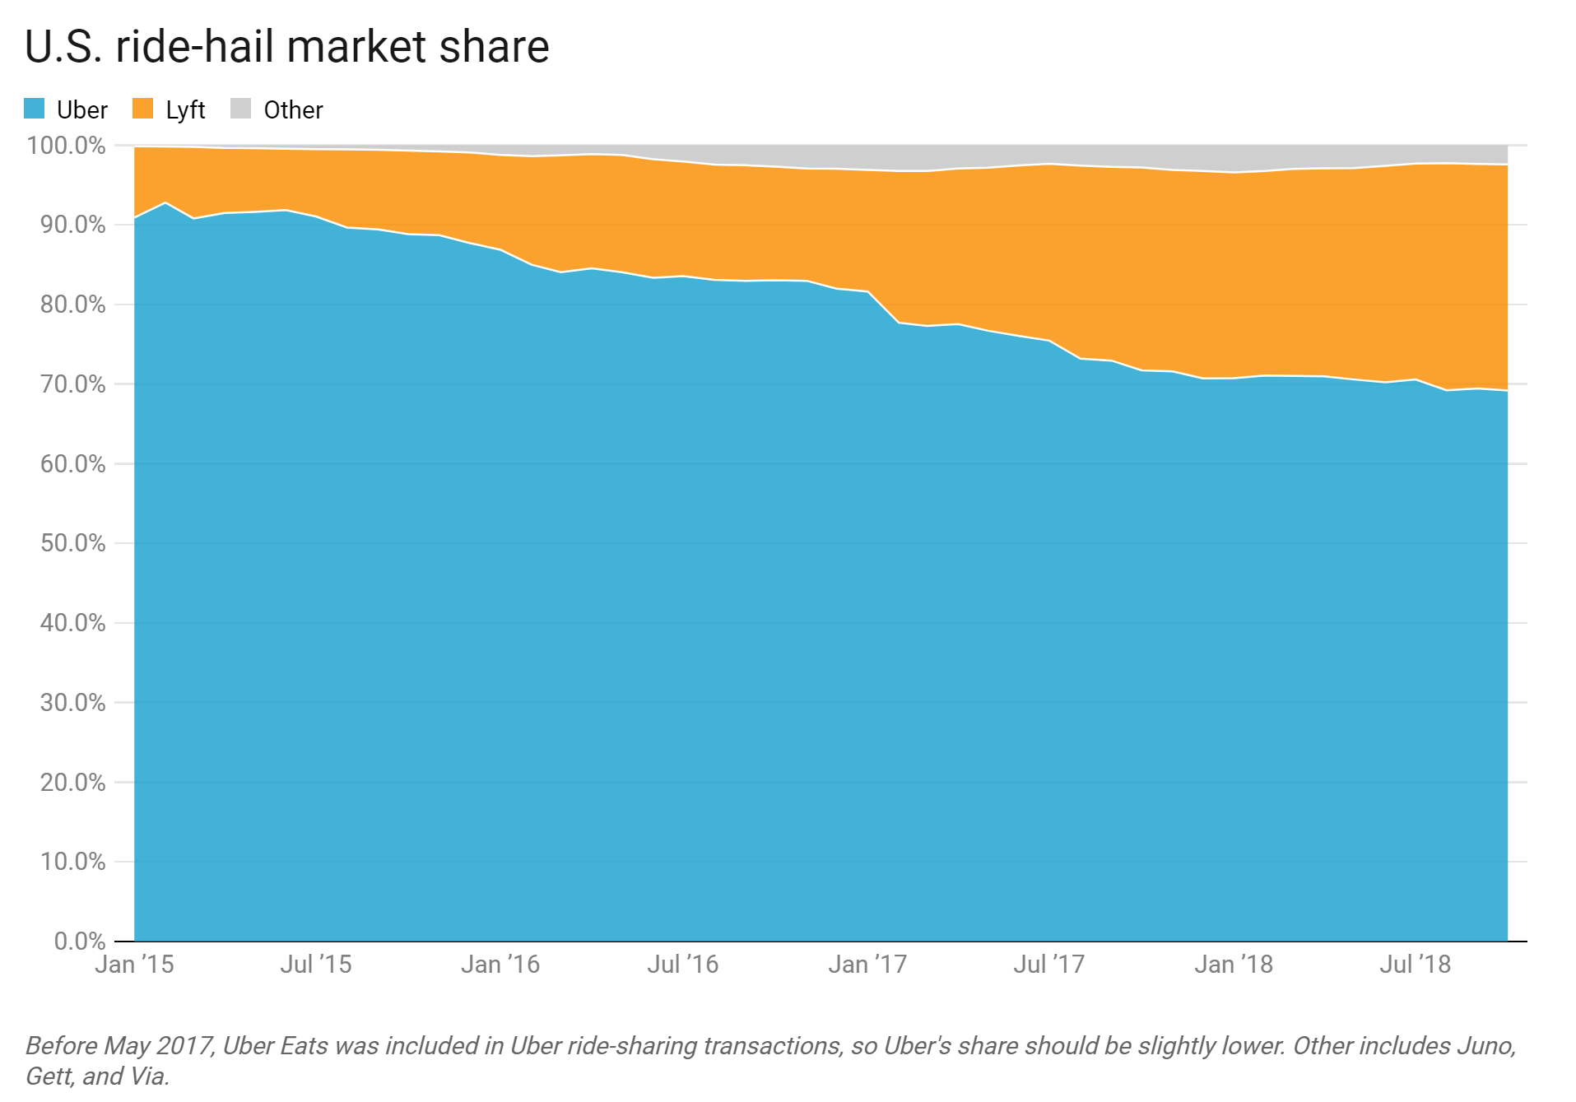

Competitor Analysis
Shared rides:
Uber
Lyft

Slide 10
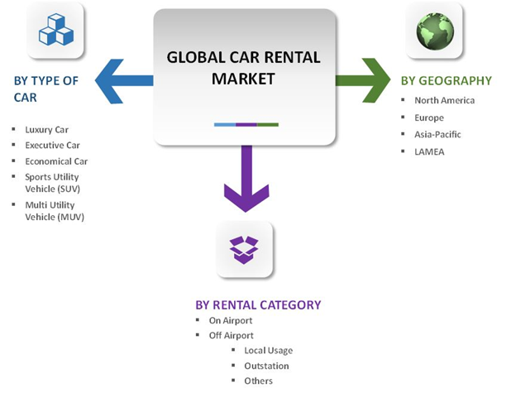
Segmentation
Data Source: Statista.com

Slide 11
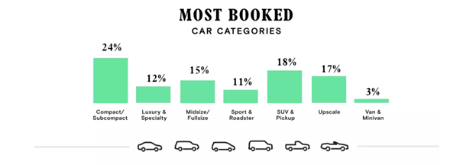
Segmentation
Economy cars accounted for our fastest growing type of car
MUV’s (Multi-Utility Vehicle) and SUV’s (Sport utility vehicles) best for safety, all-around driving, rough terrain driving or family driving
Data Source: Turo.com

Slide 12
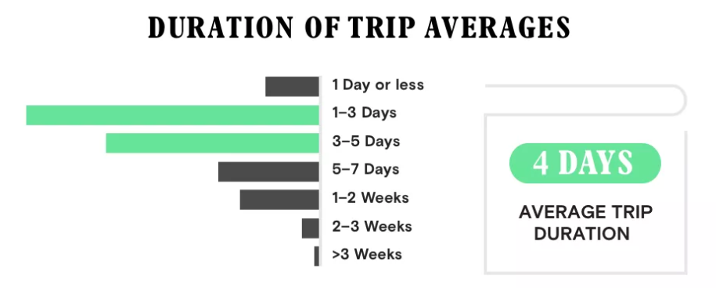
Segmentation
Based on type of trips:
On Airport - In 2016, it accounted for 41% share of the overall market share mainly because of increased air traffic volume due to rising international business activities.
Off Airport
Local usage - Average trip length is few hours
to 4 days, everyday basis.
Outstation - Average trip length is 4days to a
month, seasonal and strongest during the spring and
summer months
Others (including self-drive, event transportation and employee transportation solutions) - rare and infrequent
Data Source: Statista.com

Slide 13

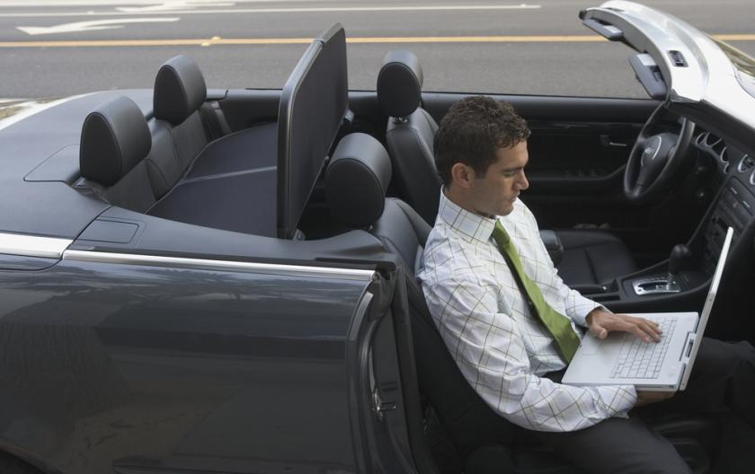

Segmentation
By type of users: Segmentation based on purpose
Leisure
Business
Local Usage
To drive around while on vacation, more price-conscious and looks for packages that will enhance their travel experience.
Business trips in another city, more value-conscious, expects punctuality and needs a car that functions properly
People who rents car for few hours to few days as a replacement or emergency
Car Owners/ Hosts
- Whose car is sitting idle 65% of time
- Who owns more than 1 car
Car Renters
- Segmentation by Age
- Segmentation based on Purpose

Slide 14
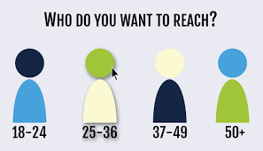
Segmentation
By type of users:
Segmentation by Age
Elders who will go for traditional packages. They are conservative and will opt for simpler solutions. They are infrequent in renting cars and can be a part of the car owners' segment.
Priority is price
18 - 24
25 - 34
35 - 54
55+
Young Adults, college graduates, and new workers. Priority is price and safety. These people are occupied with their work and are looking for options that are hassle free and convenience. They will consider all the attributes and make tradeoffs between them to find out the best deal
Adults who are looking for value added and quality services. Priority is quality and safety
Data Source: Statista.com

Slide 15
Targeting
Our Target Market
Our target market will be men aged between 25 – 34 years who are likely to be interested in renting cars for leisure purposes by promoting our price optimized (Economy), compact sized cars.
We would also focus on people aged between 35 – 44 years who travel with families. For this group, we will promote SUV and other larger vehicles that prioritizes safety.

Slide 16
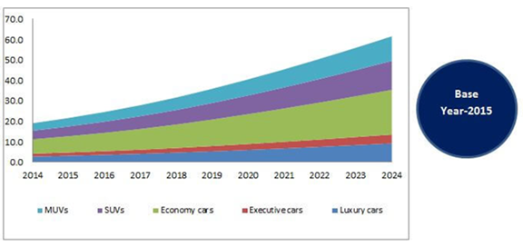
Targeting
Target segment for cars:
Economy cars accounted for
approximately 33.1% share of the
global market in terms of revenue.
This car type is price optimized
and is a convenient choice for
daily users.
It is the fastest growing type of car with Compound Annual Growth Rate (CAGR)of around 13.73%
Data Source: Statista.com

Slide 17
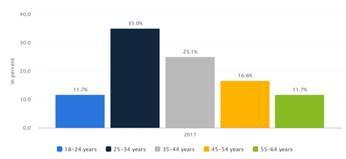
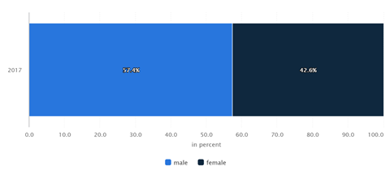
Targeting
Target segment for Customer age:
Highest car renters are between 25 – 34 years age group with 35%
This age group prioritizes price, convenience and safety.
Turo’s current strategy focuses
on the luxury car market
Target Segment for Gender:
Males more frequently rent out cars than females
Data Source: Statista.com

Slide 18
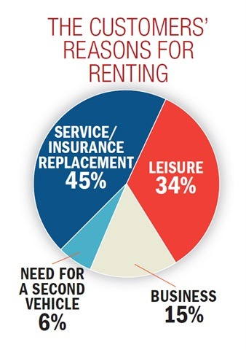
Targeting
Target Segment for Purpose:
45% of people rent out cars for replacement.
Replacements could be due to car breakdown, emergency, need of an extra car or a bigger car. We are promoting our economy cars for replacement purposes
34% of people rent cars for leisure.
The leisure purpose includes small trips, family trips, road trips and luxury rides. We will target leisure segment and promote our affordable and convenient rental service to drive the shift away from traditional renting options.
Data Source: Statista.com

Slide 19

Positioning Statement
Car Renters:
“Turo 2.0, unlike the other car rental
options gives you flexible, hassle free
car renting solution without any cost
of renting or ubering… just like renting
a car from your friend”
Owners:
“Turo 2.0, unlike other car renting
options gives you the opportunity to
make extra money effortlessly”

Slide 20
SWOT Analysis
Strengths
Lower prices compared to competitors
Peer to peer car sharing business model
First mover advantage
Mileage carry over for the customers: earn incentives in the future
Weakness
Availability of cars depends on host
Drop off inconvenience
Varied car condition: condition and cleanliness of the cars may not be as good as regular rental cars
Opportunities:
Travel industry expansion
Growth of mobile device market
Market enlargement through partnerships with hotels, insurance companies, airlines
Threats:
Heightened competition from industry stalwarts: Uber/Hertz/Lyft
New market entry competitors offering cheaper alternatives. Low barrier to entry
Potential theft/misuse of the owners' car.

Slide 21
Market Potential & Profitability
Potential Market
Costs

Slide 22
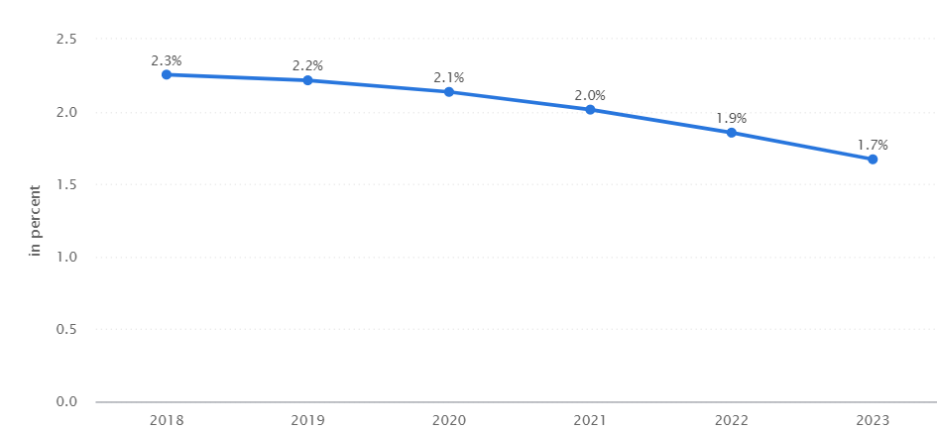
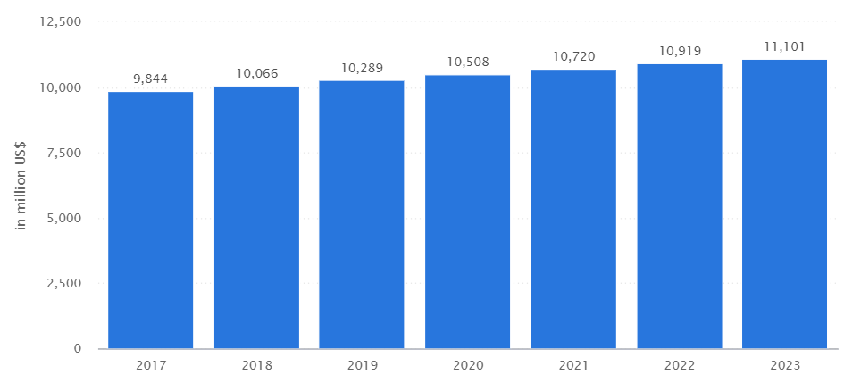
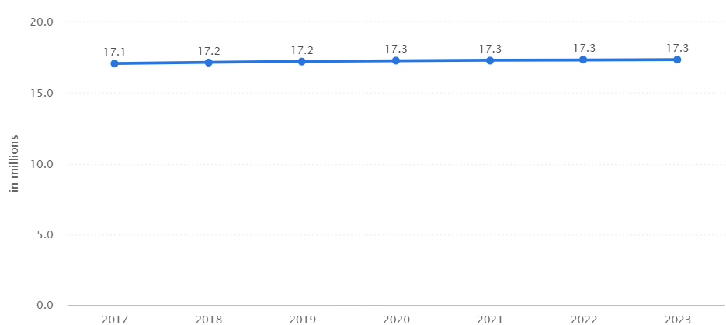
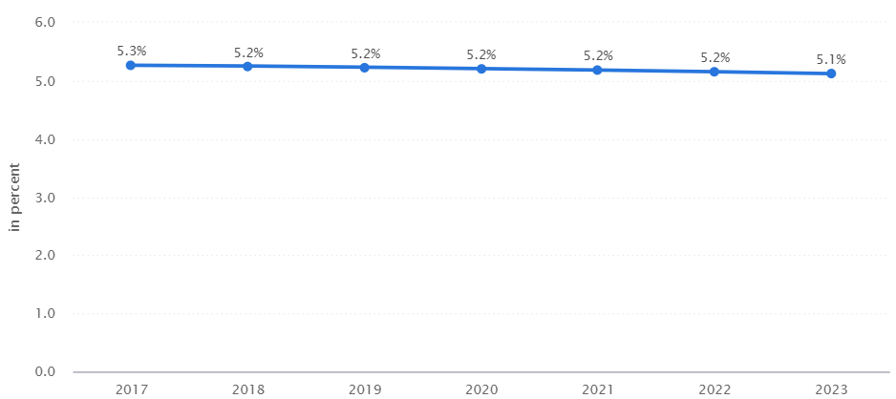
Market Potential
Revenue Growth in Percentage
Revenue Growth in Dollars
Average growth of 2.02% over 5 years
User Growth
Penetration forecast in Percentage
Data Source: Statista.com

Slide 23

Cost
Operational costs: rent, salary, equipment, marketing, insurance
Important Costs:
Marketing:
High costs in the beginning to raise awareness of our services.
This will attract more consumers to use Turo rather than
traditional car rental
User Experience:
High R&D spending to continuously improve the user
experience of both owner and consumer.
This will allow Turo to stay relevant and increase
customer retention.

Slide 24
Marketing Plan
Product
Promotion
Pricing
Rollout Strategy
Limitation & Threat Analysis

Slide 25
Turo vs. Turo 2.0 Strategy
Luxury vs. Economy
Turo’s currency strategy focus on luxury market
Turo 2.0 plans to market to the economy class
Why?
Data proving economy class market is bigger than luxury:
45% market is replacement car, and the replacement cars wouldn’t be luxury cars.
Age 25-34 cannot afford luxury but they’re the biggest market
Economic car accounted for 33% of the global rental car market share while luxury cars were much lower
Thus, Turo 2.0 has potential to capture more market share with the new target segment.

Slide 26

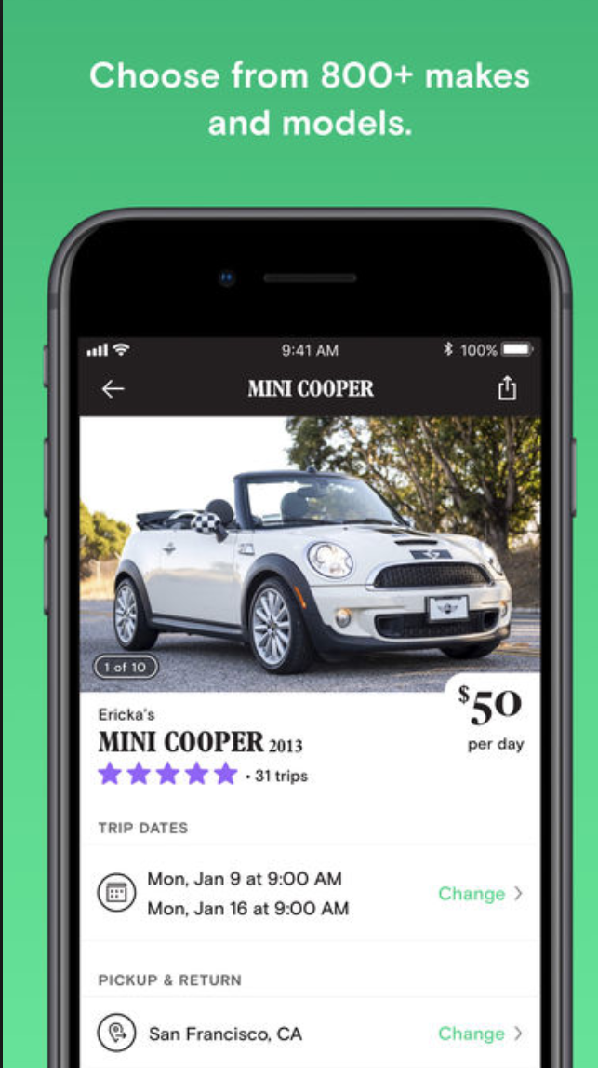

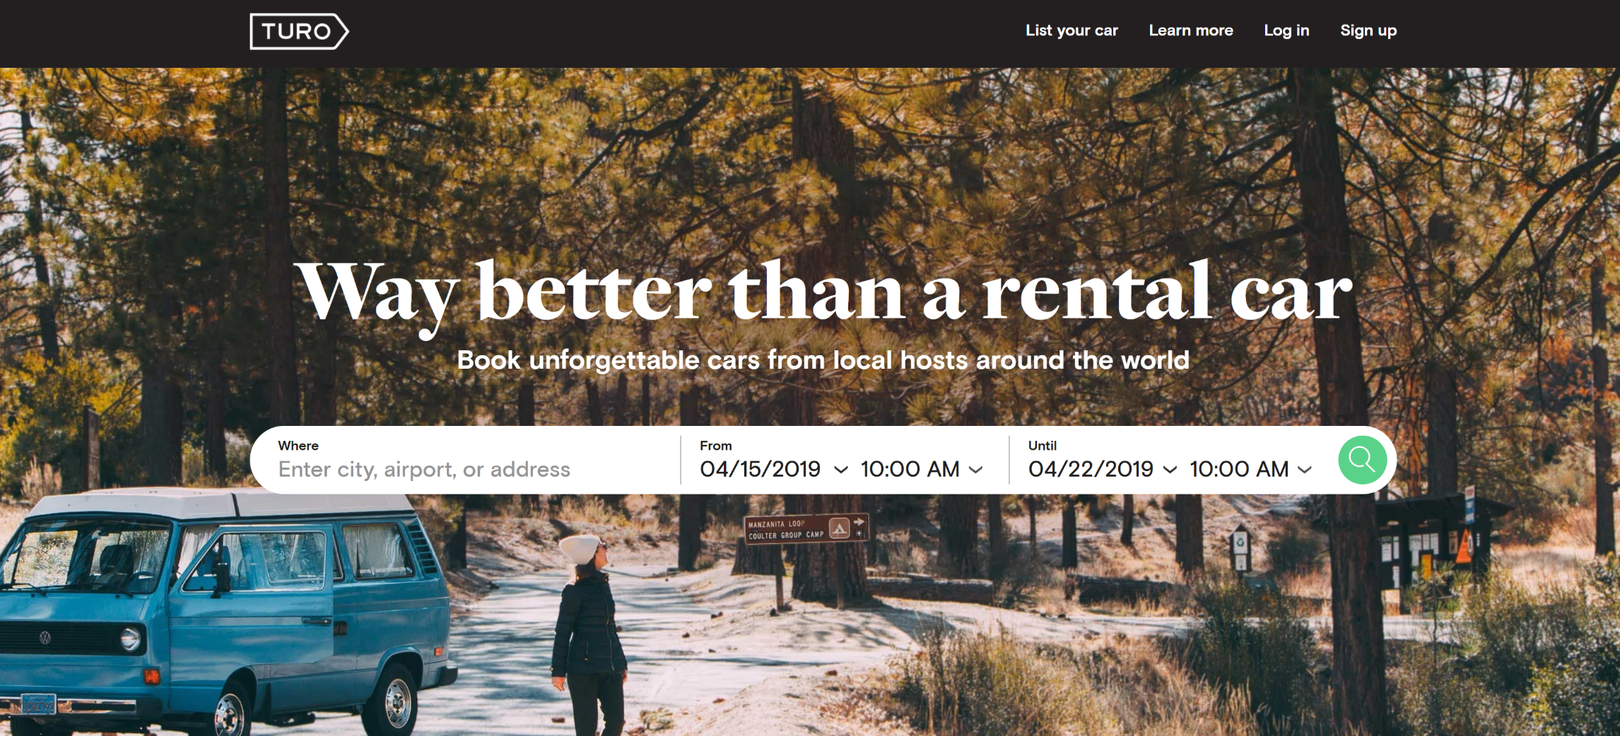
Product
TURO:
Economic cars as temporary replacement
Cars for road trips and vacations
Variety of selections of Luxury and Vintage cars
Vans and trucks for moving or just pure leisure

Slide 27
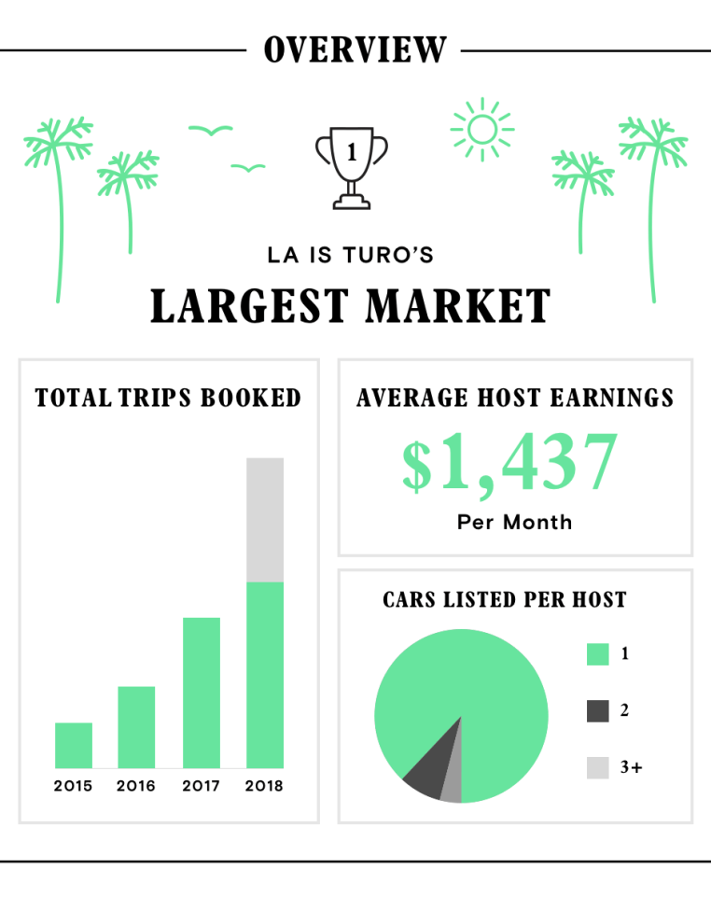
Pricing
Automatic (Turo’s algorithm) or Manual (Owners)
Renter’s Earnings: Depends on level of insurance
Premiere: 60% of the trip price
Standard: 40%
Minimum: 15% - 25%
Decline: 0%
**If renter has commercial rental insurance to cover the car, and the customers, they can waive vehicle protection provided via Turo and earn 90% of the trip price.**
Carculator app to calculate their potential earnings
Discounts, incentives, etc.
Promo codes for first time use
Promo codes for referrals
Rewards for mileage/#number of rentals
Seasonal price hike
Higher in summer due to higher demand
Higher in popular places
Lower or equivalent to traditional rentals
Notes:
https://www.ridester.com/turo-car-rental/
Turo will set the car’s price based on market value, location, time of year, and other data sets to maximize the revenue and boost the listing’s competitiveness.

Slide 28








Promotion
Airbnb for cars, way better than a rental car
Focus: Young adults
Ways of Promotion:
Digital Promotions Print Media
Celebrity Endorsement

Slide 29


Distribution
Reserve Cars (Online) Distribution (Offline)
App (IOS & Android) They can pick up the car from the car owner
Website: www.Turo.com Car owners can also drop off their car at the renter's preferred location for extra price

Slide 30
What if big companies try to copy our service?
Customers like accumulating their mileages and their status that provides them with future rewards such as discounts and benefits. The customer would not want to move to another company and lose out on the benefits.
Copyrights & patents
Keep Innovating to stay ahead in the market
Keep our service simple and convenient

Slide 31
Q&A

Slide 32
Rollout Strategy
Time frame
National rollout

